Slide 1
Crowd Size Management for COVID-19
CMPE 286 - Internet of Things
Name: | Class ID:
Chauhan, Priyam | 6
Katturu, Manish | 15

Slide 2
Contents
Problem Statement
Hardware and Software
Flow of the Process
Architecture
Results
Future Scope
Demo

Slide 3
Problem Statement
The objective of “Crowd Size Management” is to get the counter of number of people in the selected area of any place like offices, event centers, social gatherings, or any public location. The main objective is to consider the current scenario of COVID-19 and apply these concepts of IoT for that. There are certain restriction and guidelines put for the people’s safety to minimize the spread of coronavirus. And one of them is to keep limits on the number of people gathered in a certain place together.
But sometimes it goes out of notice, and there are more than mentioned people in the certain area. This does not only break the regulations but also becomes harmful for the people. So, this idea can be used there, and it can work for monitoring and alerting if the crowd size increases, without physically being present in the overcrowded contagious areas.

Slide 4
Hardware and Software
Hardware
Raspberry Pi 4B
Pi Camera Module
Specifications:
2592 x 1944 Pixel Static Images,
1080 p @ 30 fps, 720 p @ 60 fps and 640 x480 p 60/90 Video Recording,
5 Megapixel sensor OV5647
Software
OpenCV
ThingSpeak
Python

Slide 5
Flow of the Process
In the configuration with Raspberry Pi 4B
“Histogram of Oriented Gradients (HOG)” to detect the objects, here people, in the images
For detection of people
Data frames are captured through the Pi Camera Module
For count of the people
Data frames are processed with HOG
1
Data frames are compared to pre-trained model of OpenCV
2
Counter updated and shown on ThingSpeak channel dashboard
3
4

Slide 6



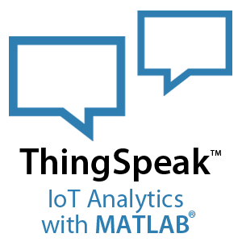
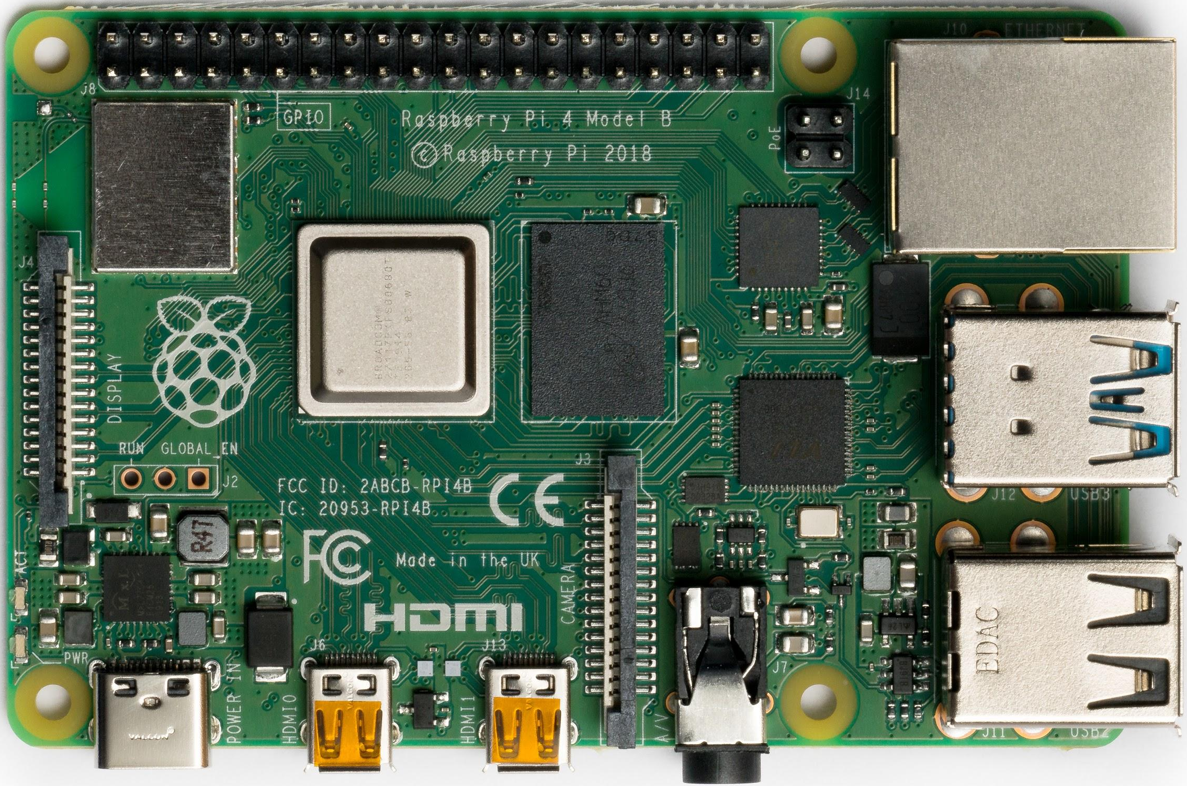

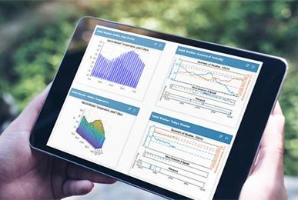
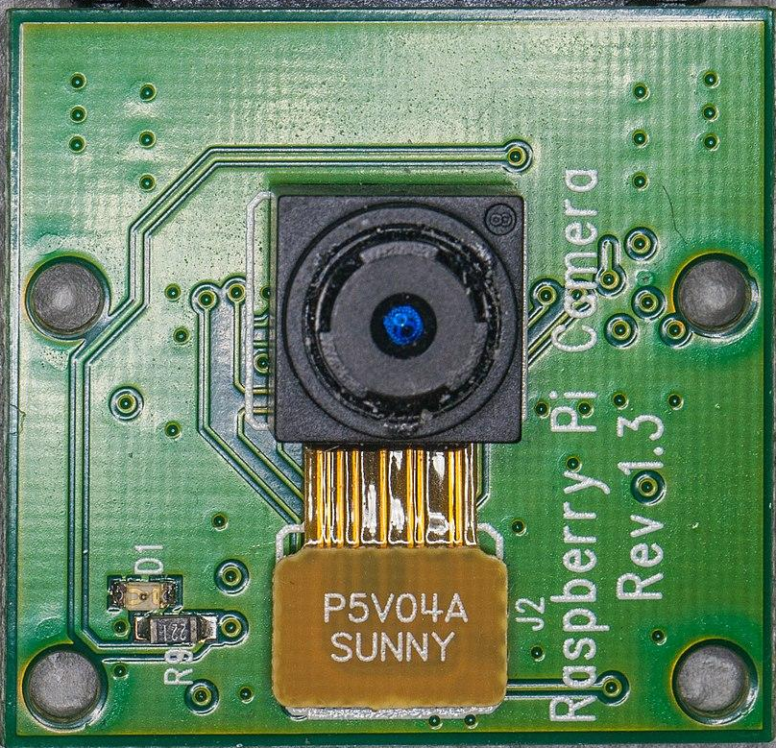

Architecture
HOG

Slide 7

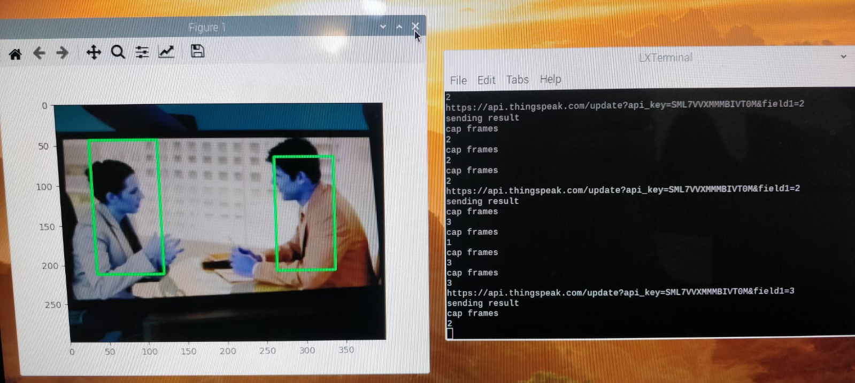
Detection Results
Fig.: Detection through Pi Camera and Counter on screen
Fig.: Actual Image

Slide 8
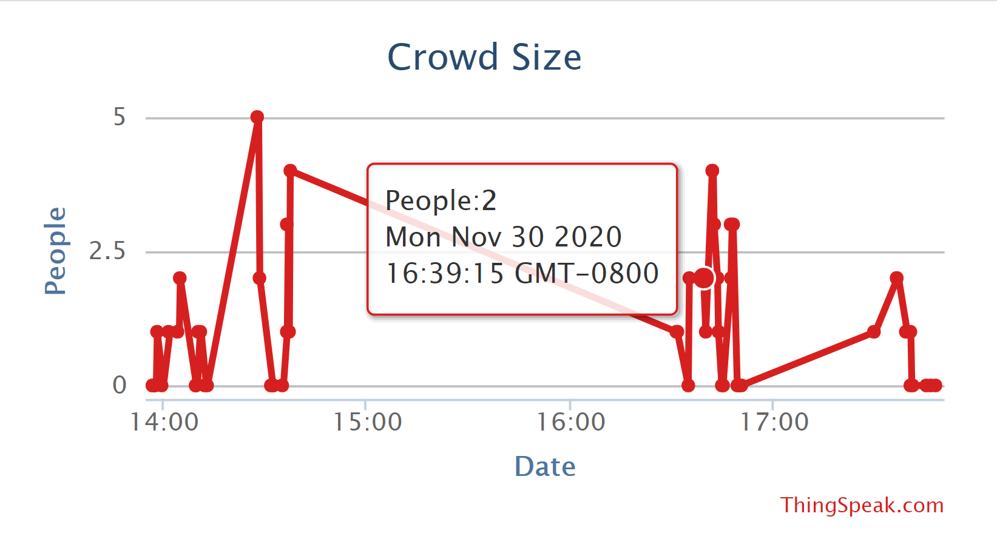
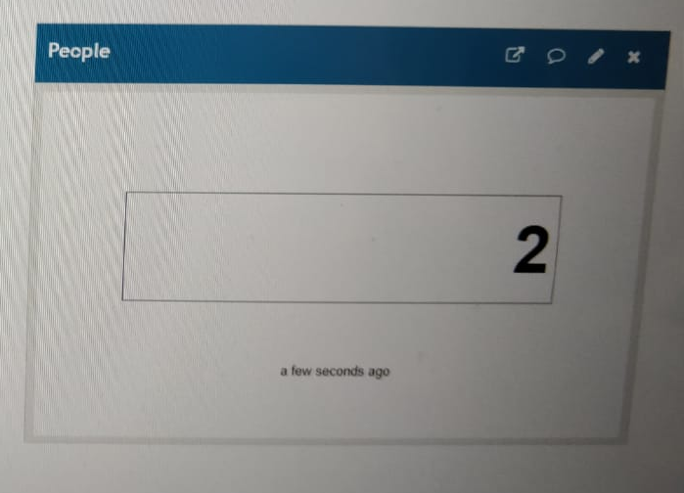
ThingSpeak Results
Fig.: Graph with Time, Date and Number
Fig.: People Counter on ThingSpeak

Slide 9

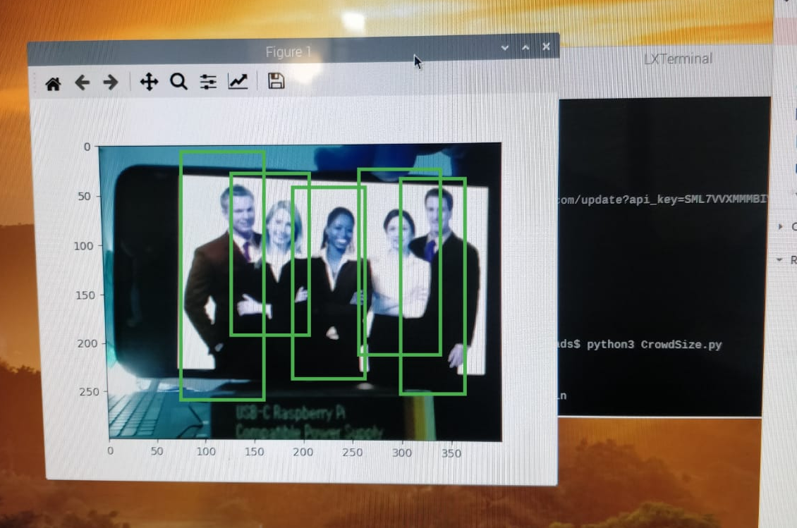
Detection Results
Fig.: Detection through Pi Camera and Counter on screen
Fig.: Actual Image

Slide 10
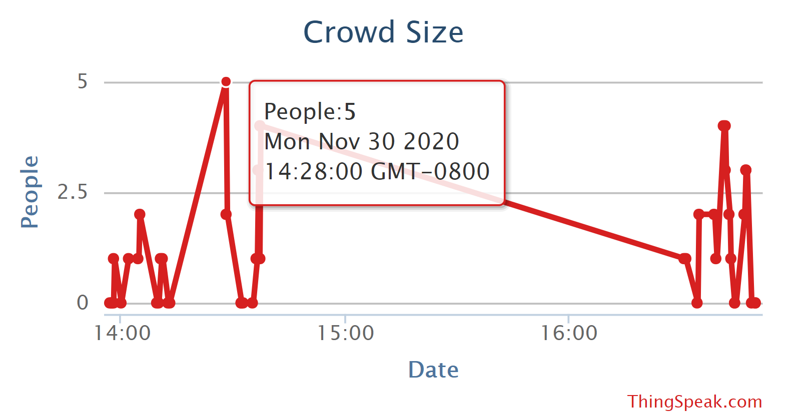
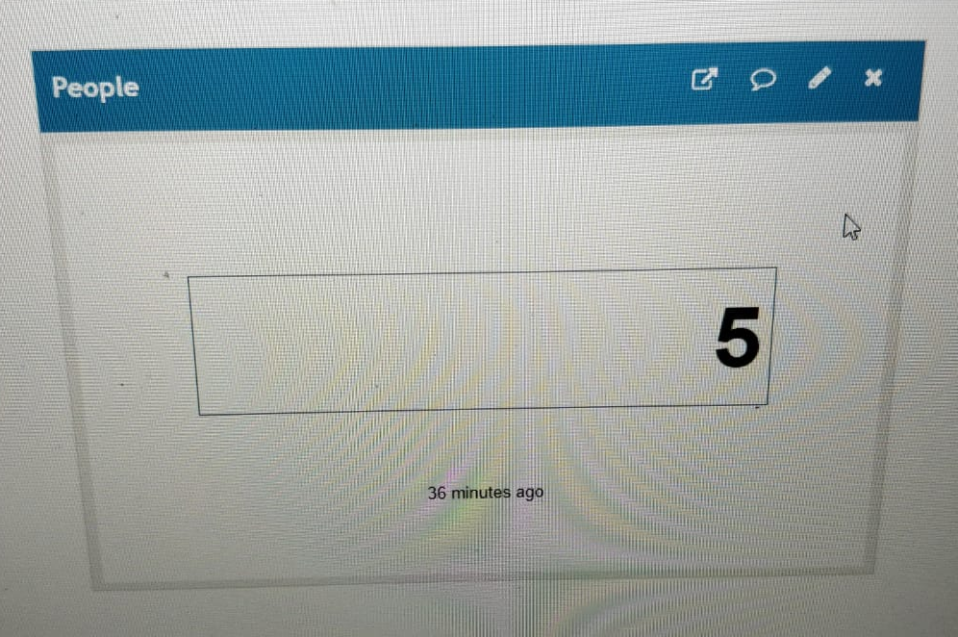
ThingSpeak Results
Fig.: Graph with Time, Date and Number
Fig.: People Counter on ThingSpeak

Slide 11
Future Scope
We can combine this project with the ‘Face Mask Detection’ and make it work as a whole system for COVID-19 to check on the people if they are maintaining the limited crowd size or not with their mask on.

Slide 12
Demo

Slide 13
Thank you!

